Slide 1
Be Happy
Kyle James

Slide 2
In this socially dark, light-hearted platformer, you are the only happy person left in the world where you are tasked with bringing happiness back to the people.

Slide 3
Narrative Lead
The world has found itself at an all-time low, and although you don’t have a job, you find joy in every aspect of life. As the main character, Stone, you seek to enlighten the people around you and show people the beauty of life. You work alone to help people realize that life isn’t all about their jobs, but rather the experiences that they have, and that money does not buy them happiness. Although the goal is noble, can one man really make that much of a difference and alert the city to wake up and smell the roses? Can a drab world really be brightened by one man and a balloon?

Slide 4

Reference Image 1
Cyrus - Trying Cover Art
https://genius.com/albums/Cyrus/Trying
This image is a concept that I have in mind for the main character as he traverses throughout the platformer to make the “enemies” happy. I particularly find the balloon to be an exciting part of the design.

Slide 5
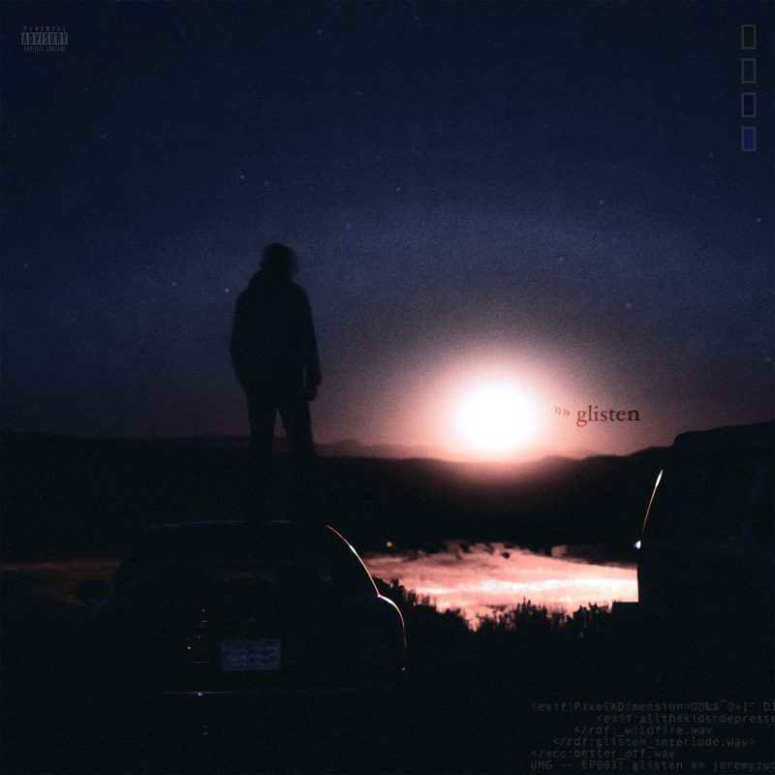
Reference Image 2
Jeremy Zucker - glisten EP Cover Art
https://genius.com/albums/Jeremy-zucker/Glisten-ep
The relevance of the image is the tone. I find the darkness in the image to represent the dark place that the enemies are in. The light in the backdrop represents the light that the main character is trying to bring to the dark place.

Slide 6
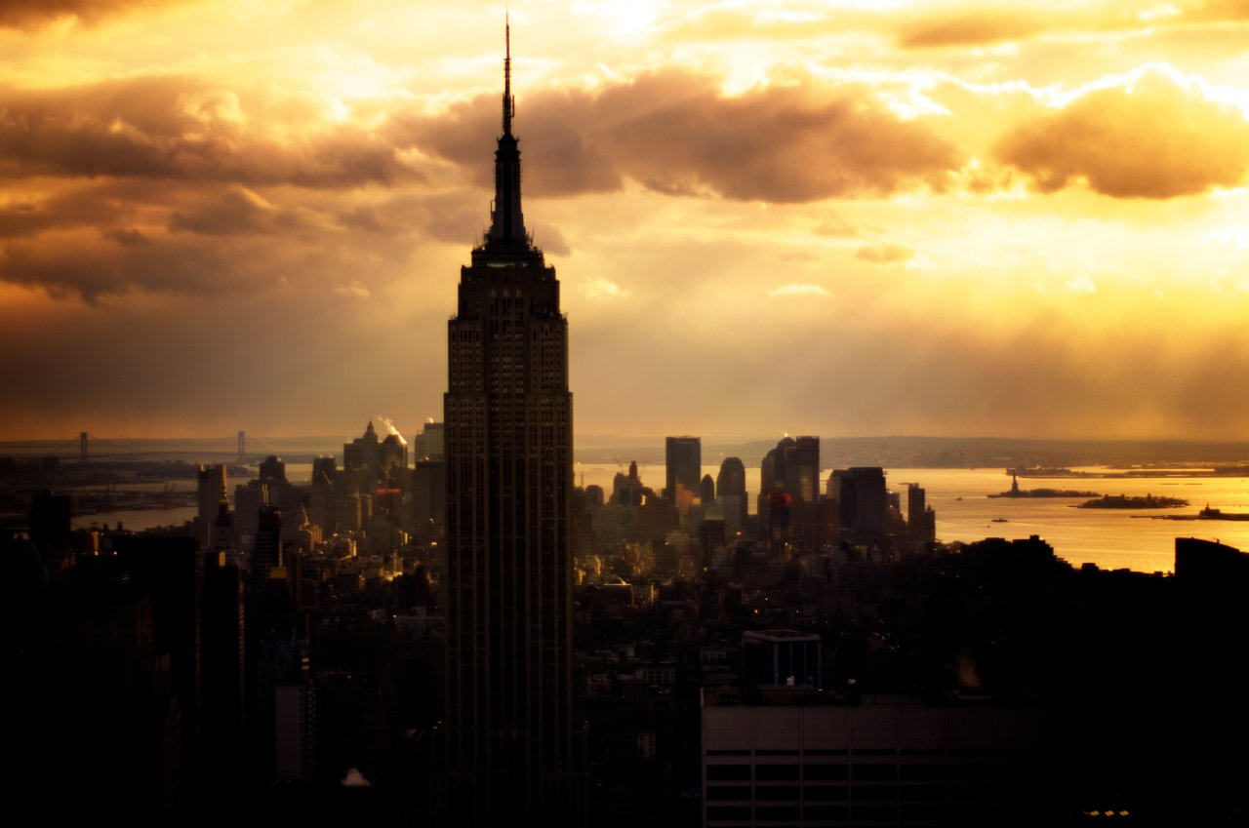
Reference Image 3
SwagyTracks - Man of the Year Video Image
https://swagytracks.tumblr.com/image/49927997222
Despite the beauty and light outside of city limits, it is dark within the city, which speaks volumes to the tone that I’m trying to set. People only worry about man-made constructs and fail to recognize the beauty around them.

Slide 7
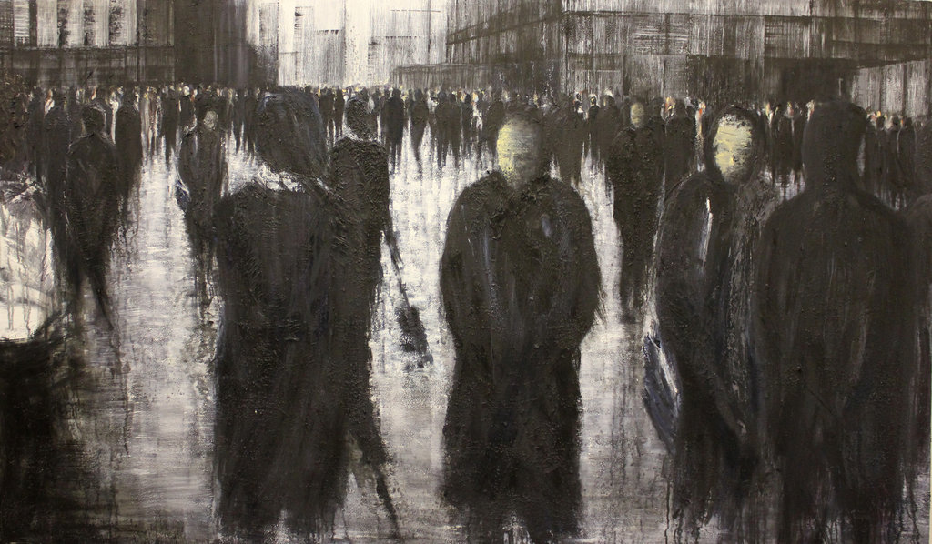
Reference Image 4
Depressed City
http://rebloggy.com/post/illustration-art-people-depressed-sad-collection-city-traditional-art-surrealism/78315871074
The faceless characters are interesting as they live a depressing life but do their best to hide their emotions. I find this inspiring for the “enemies” in the game that you attempt to bring happiness to.

Slide 8
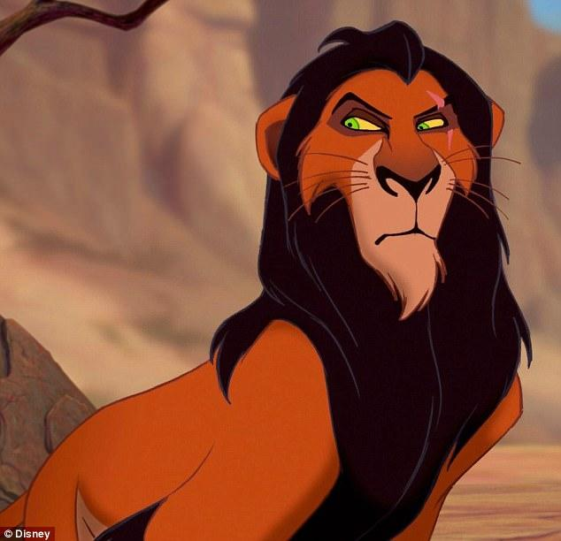
Reference Image 5
Lion King - Scar
https://www.dailymail.co.uk/tvshowbiz/article-4755828/Chiwetel-Ejiofor-talks-voice-Scar-Lion-King.html
The pose of Scar in this image is a critical idea that I’d like to include for the “boss enemies” that the player character faces. The CEO’s will have similar drives to Scar with the willingness to do anything to get what they desire.

Slide 9

Reference Image 6
Colorful Flower in Black & White World
https://helpx.adobe.com/photoshop/how-to/black-and-white-with-color-photo.html
The idea of the colorful flowers infecting the black and white background is something I find particularly interesting. I want the color to represent happiness and have it contaminate the bleak surroundings in the game.

Slide 10

Reference Image 7
Office Worker
https://www.pinclipart.com/pindetail/iihJTb_general-affairs-office-work-clipart-black-and-white/
The pose in this picture is crucial as I’d like to represent the unhappy people with poor posture as they only focus on work.

Slide 11

Reference Image 8
Smiley Face
https://en.wikipedia.org/wiki/File:Smile.svg
Opposed to coins that typical platformers include, I’d like to incorporate the idea of happiness level instead, by helping unhappy people become happy. The “currency” in the game would be their smiles.

Slide 12
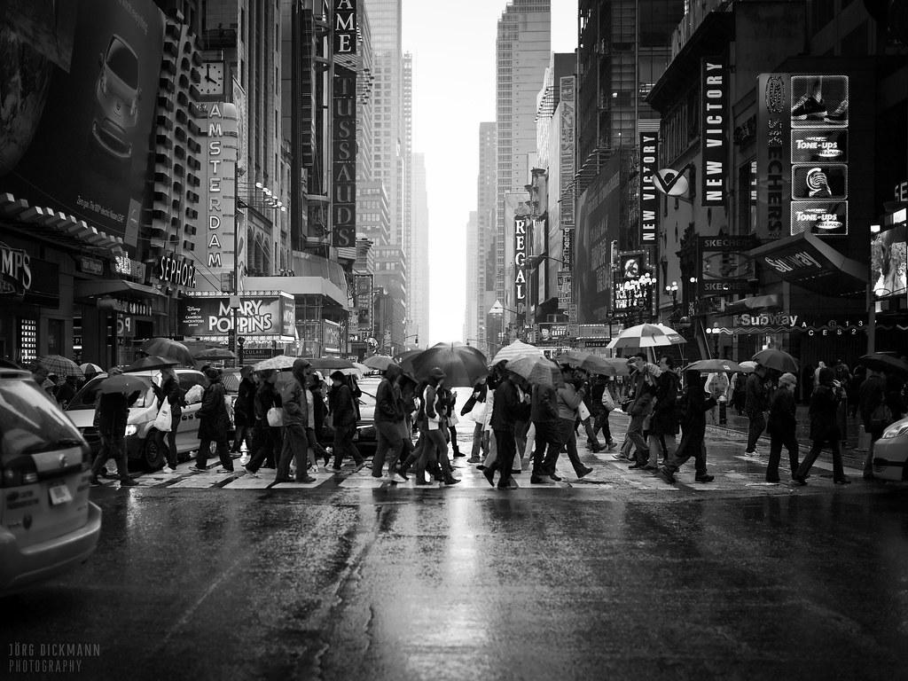
Reference Image 9
Rainy City
https://www.flickr.com/photos/dickmann/5683284766
The hustle, bustle, and impersonal streets of a city is an energy I’m reaching for as it shows how people are not as happy as they could be.

Slide 13
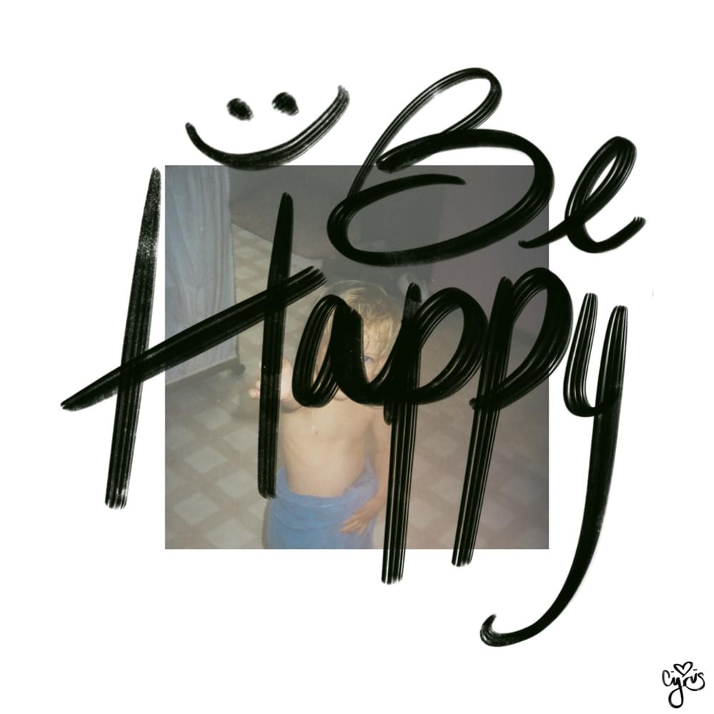
Reference Image 10
Be Happy Cover Image
https://genius.com/Cyrus-be-happy-sometimes-lyrics
The bubbly, happy, light-hearted lettering is something I find exciting and helped inspire the title of the game. I also find the idea that there’s a young child on the cover that people always look back at childhood as a happy time, but now all the kids are depressed.

Slide 14
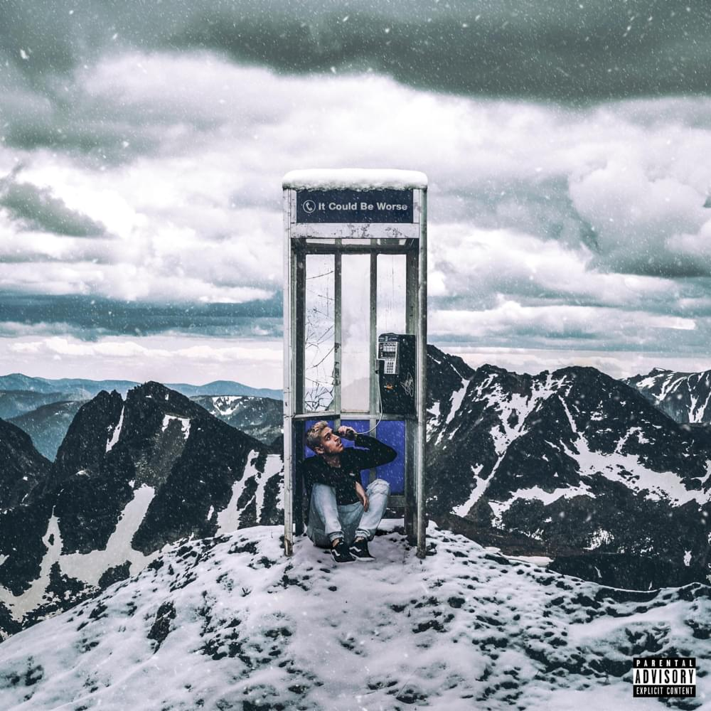
Reference Image 11
Adrian Stresow - It Could Be Worse
https://genius.com/Adrian-stresow-it-could-be-worse-lyrics
I like the tone that the image represents in that everybody feels alone and cold, and that every connection is artificial. I’m interested in having the game reflect that.

Slide 15
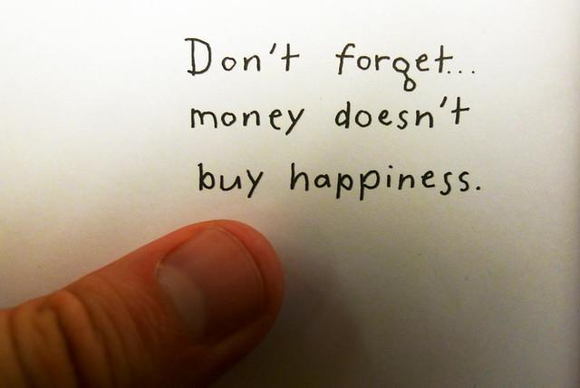
Reference Image 12
Money Doesn’t Buy You Happiness
https://www.flickr.com/photos/49633031@N06/4773045670/
The content of this image speaks volumes to the point I’m trying to get across. I want to scale enemy difficulty (more challenging to make happier) with how much money they have. If they have a lot of money but work all the time, they will be harder to defeat (make happy).

Slide 16
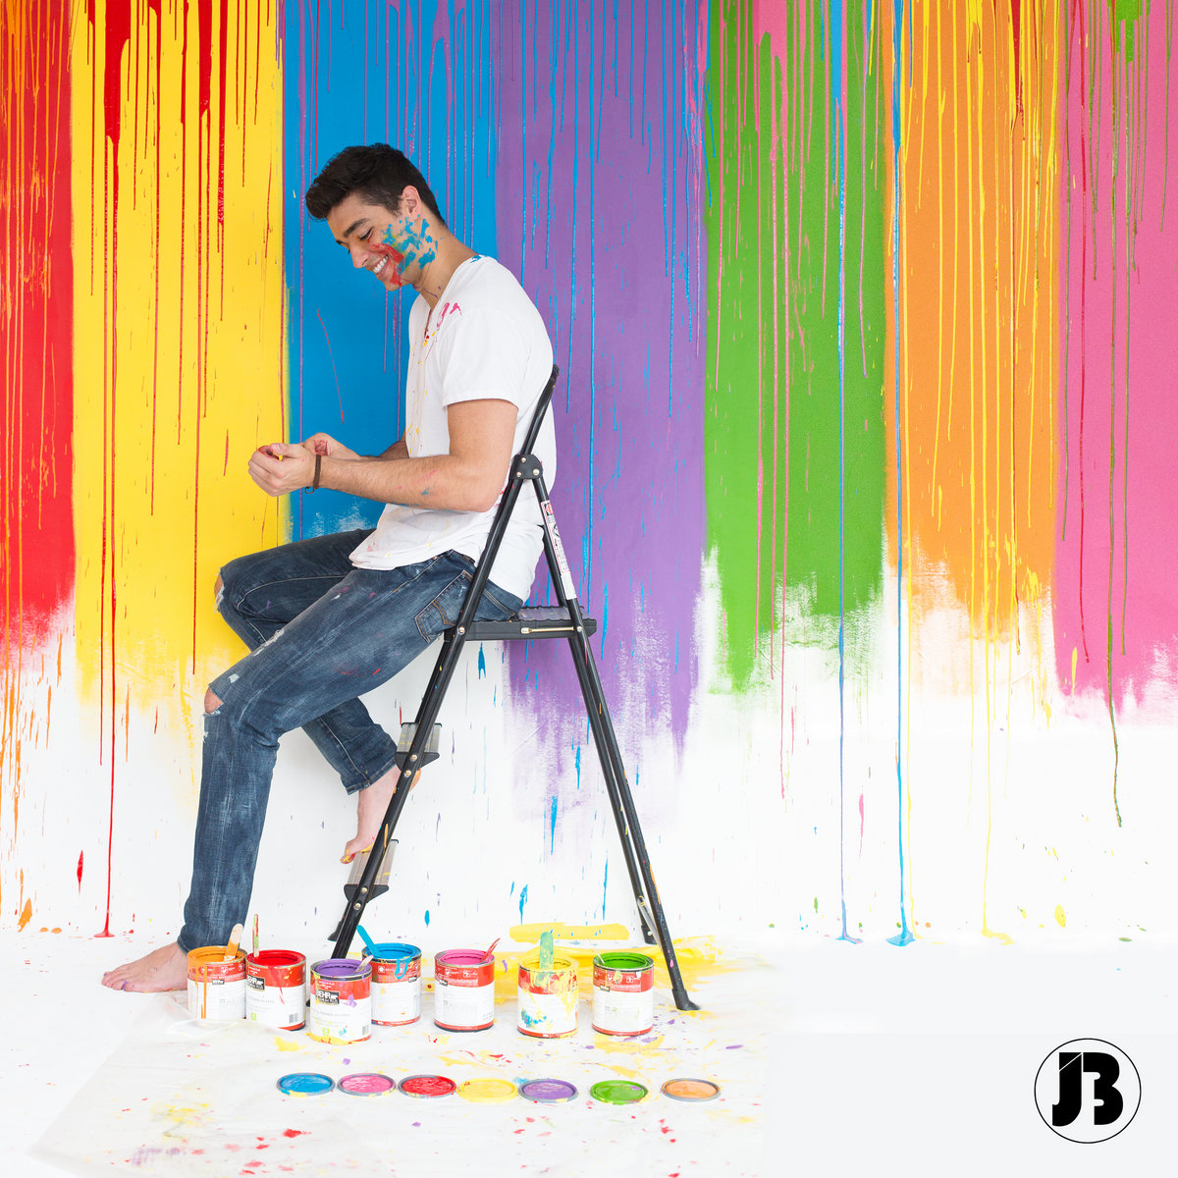
Reference Image 13
Joey Burbs - Not In That Order Cover Image
https://joeyburbs.bandcamp.com/
The colors in the image represent the happiness that people experience when they seek out the beauty in things. I’m interested in having friendly NPCs that found true happiness through art, hiking, reading, or other hobbies that don’t revolve around making money.

Slide 17

Reference Image 14
Lots of Balloons
https://alongtheyellowbrickroad.wordpress.com/2014/01/25/looking-for-happiness-in-all-the-wrong-places-on-the-ybr/
The content of the image is excellent as the person holds several balloons. This might be a concept worth exploring as the main character progress and achieves balloons to show their progress.

Slide 18
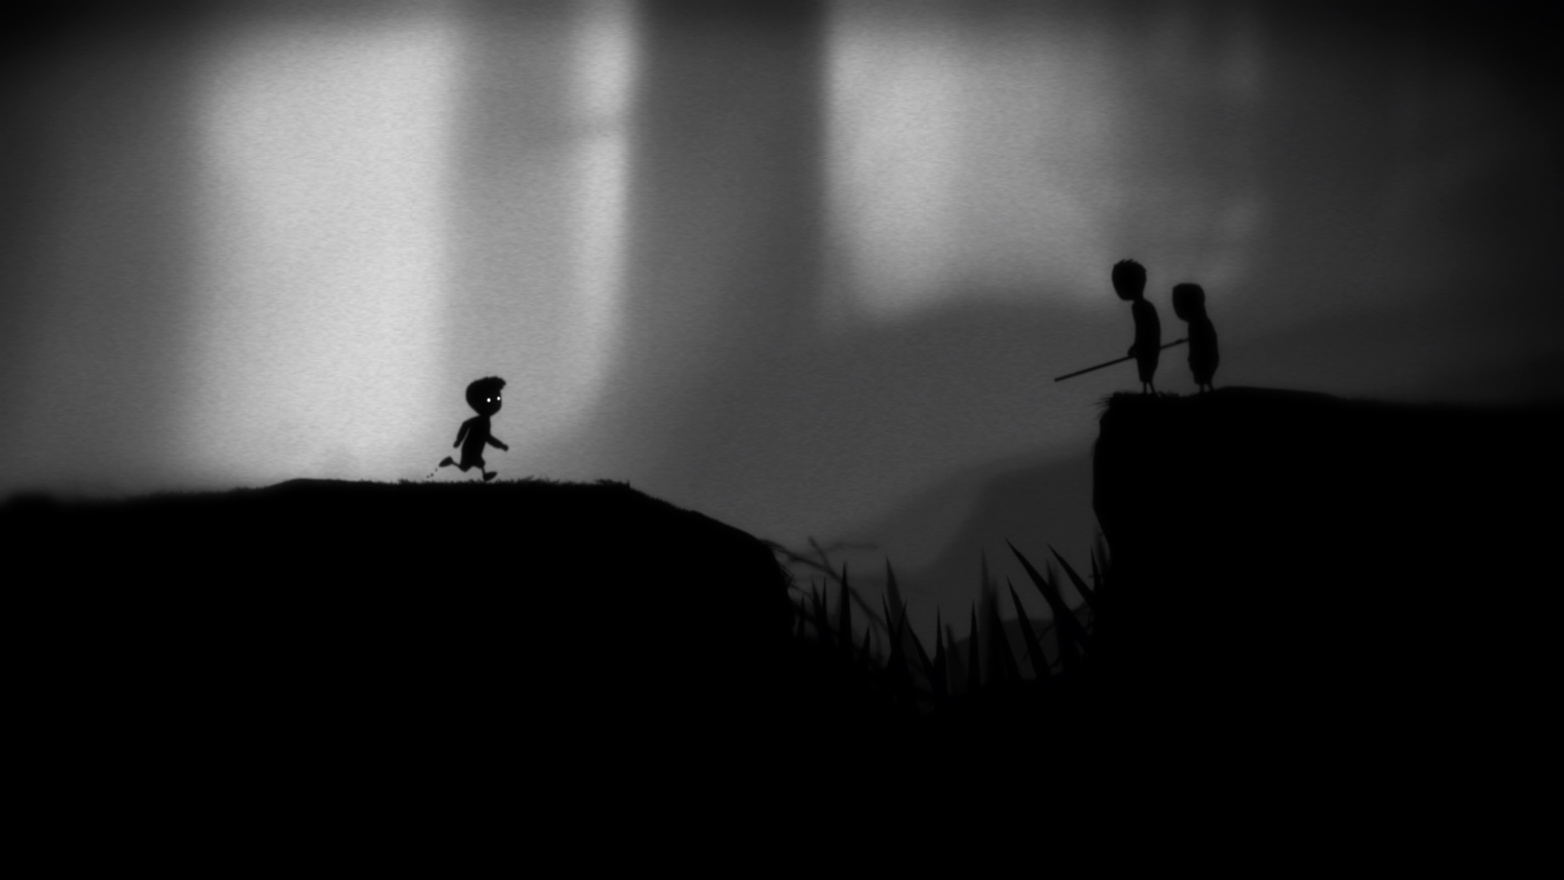
Reference Image 15
Limbo Screenshot
darkzero.co.uk/game-reviews/limbo-xbox-360/
Although shown in class, I found Limbo to be a fascinating reference point for this game. Instead of being grayscale the entire time, I want to focus on the transition to bright colors, especially as people becoming happy, and the world becomes less drab.

